Slide 1
U.C. Berkeley: Economics 115: Spring 2020
20th Century Economic History: Lecture 3: North Atlantic Political Economy
Brad DeLong
Department of Economics and Blum Center, U.C. Berkeley; and WCEG
delong@econ.berkeley.edu
last revised: 2020-01-29
for delivery: M 2020-02-03 17:00 HMMB390
<https://bcourses.berkeley.edu/courses/1487684>
<https://github.com/braddelong/public-files/blob/master/econ-115-lecture-3.pptx>

Slide 2
About the Course
The long 20th century will in all likelihood be seen in the future as the watershed in human experience:
Nine aspects:
History was economic…
Explosion of wealth…
Cornucopia of technology…
Demographic transition…
Feminist revolution…
Empowered tyrannies…
Wealth gulfs…
Inclusion and hierarchy attenuation…
Mismanagement and insecurity…
Humanity is unlikely to see as transformative—for good and ill, but mostly for good, I think—a century again…

Slide 3
Pre-1870 Political Economy
From “Divine Right” and “Natural Order” to Enlightenment values…
Who was the first person to draft these words:?
“We hold these truths to be sacred & undeniable:
that all men are created equal & independant,
that from that equal creation they derive rights inherent & inalienable,
among which are the preservation of life, & liberty, & the pursuit of happiness;
that to secure these ends, governments are instituted among men, deriving their just powers from the consent of the governed…”
John Locke
Nicolo Machiavelli
Thomas Hobbes
Thomas Jefferson
George Washington
Why did he write them?

Slide 4
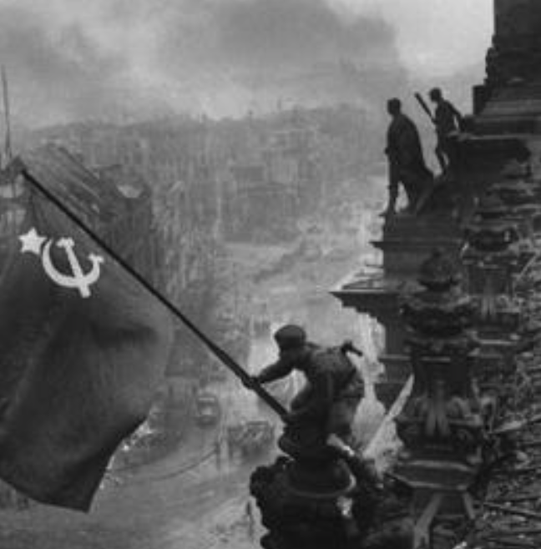
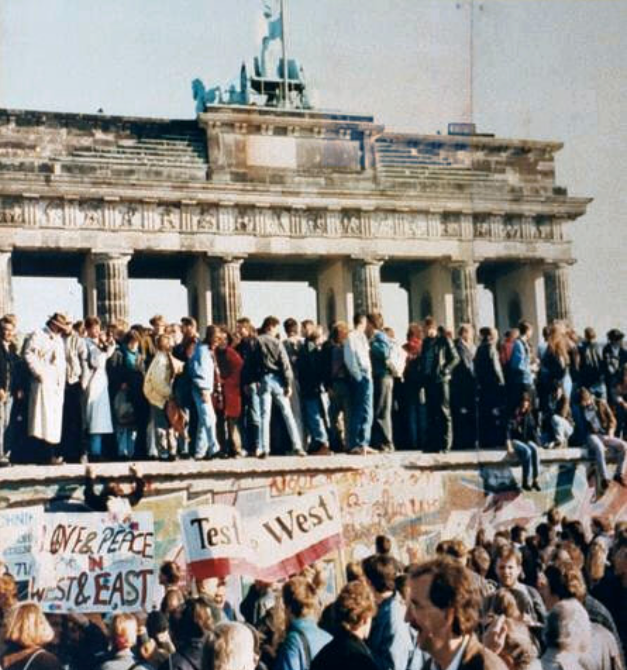
What Was the Proper Political Order?
Fears of “democracy” among American founders:
Madison: “Democracies have ever been spectacles of turbulence and contention... incompatible with personal security or the rights of property... as short in their lives as... violent in their deaths…”
Jefferson: “Gen’l Washington had not a firm confidence in the durability of our government… [& this] had some weight in his adoption of… ceremonies… calculated to prepare us gradually for a change which he believed possible…”
Hamilton: “the British government… best” as the only one “unit[ing] public strength with individual security…”
Adams: The American president should be announced as: “His Highness, the President of the United States, and Protector of the Rights of the Same…”
Question of political order thought settled: first in the rubble of Berlin in 1945, and then in the streets of East Germany in 1991:
Settled in favor of representative democracy, private property, & social insurance—late-1900s liberal democracy
But now reopened? Min Zhu (朱民) to me in 2015: “What are you Americans going to do to fix your broken political system?”

Slide 5
Franchise Restricted to the Rich Could Not Maintain Itself
The dynamic of franchise extension
Liberals in power would try extend on the principle that the new, poorer voters would be less conservative and would support them.
Threatening revolution would lead even conservatives to seek to extent the franchise in order to peel off of the revolutionary coalition those of the disenfranchised who had the most social power:
Earl Grey (yes, the tea): “The Principal… is to prevent… revolution…. I am reforming to preserve, not to overthrow…”
Charismatic leaders with popular followings would seek to give them votes, and then rule via plebiscites—going around the traditional elites
(Peculiar thing about Trump-Johnson: minority, and core is a minority of a minority…)
Conservatives: “dish the Whigs”—opportunities to form winning coalitions by appealing to those who were no profiting from the market economy, or felt that they were losing relative status in some ways…

Slide 6
Popular Government and the Market Economy: Prioritize Freedom
Friedrich von Hayek
A free society cannot be a just one…
To demand both is to commit a category mistake
“[Any] principle of distributive justice, once introduced, would not be fulfilled until the whole of society was organized in accordance with it. This would produce a kind of society which in all essential respects would be the opposite of a free society…”
Freedom as priority…
& (fortunately) freedom brings prosperity

Slide 7
Popular Government and the Market Economy: Society’s Revenge
Karl Polanyi
People think they have rights—to stable, supportive, nurturing communities; to incomes commensurate with their skills and status; and to money flows that will provide economic stability…
But a market society turns these things—land, labor, and finance—into commodities…
But they are not real commodities, they are fictitious commodities
And so you get your rights only if they satisfy a market profitability test
The only rights a market society respects are property rights:
& the only property rights that are worth anything are those that help you produce things from which rich people have a serious jones
Society will have its revenge: it will protect itself against the market logic, somehow, some way…

Slide 8
Digression: 5 Thinkers
Who shape my thought about the long 20th century—and how should, I think, shape yours
Beware! They are all deeply flawed…
But they are also geniuses, each in his way…
Beware of their followers! An iron law of ideology: a thinker’s most extravagant and aggressive followers will latch onto the stupidest and most shortsighted and wrong of their doctrines…
In historical order: Marx, Keynes, Hayek, Polanyi, Gellner
The other three thinkers:
Keynes: All that we need is technical adjustments to our system. Then the kngdom of freedom and prosperity will be within our grasp—and our major problems will no longer be economic one
Gellner: The energy that most 19th century thinkers thought would go to “class“ went to “ethnos“ or “umma“ instead. The construction of ideological legitimations that makes sense both to dominants and into submissive who nevertheless believe they are part of some in-group is the key to understanding how societies stabilize themselves
Marx: Only the market economy will focus society’s energy on paying through the nose to boost the economy’s capital stock and to harvest the fruits of science and technology and then deploy them in production. But because the only demand in a market economy that matter are effective demands, the market economy also becomes a more “effective” means of slavery, for private property leads the proletariat to enslave themselves

Slide 9
Hayek and Polanyi
Thumbnails on our first two:
Hayek:
Only the market economy can use society’s knowledge.
But the market economy cannot produce “social justice” and should not be asked to try—in fact, we need to recognize that all we can attain is freedom, and that will bring general prosperity, but that justice will be forever outside our reach
Polanyi:
The market economy turns land, labor, and finance into “fictitious commodities”
Society will have its revenge via a “double movement”

Slide 10
Plus Tocqueville
Toqueville on the rich as “elder brothers” in 1848:
“In the country all the landed proprietors, whatever their origin, antecedents, education or means, had come together, and seemed to form but one class: all former political hatred and rivalry of caste or fortune had disappeared from view. There was no more jealousy or pride displayed between the peasant and the squire, the nobleman and the commoner; instead, I found mutual confidence, reciprocal friendliness, and regard. Property had become, with all those who owned it, a sort of badge of fraternity. The wealthy were the elder, the less endowed the younger brothers; but all considered themselves members of one family, having the same interest in defending the common inheritance. As the French Revolution had infinitely increased the number of land-owners, the whole population seemed to belong to that vast family. I had never seen anything like it, nor had anyone in France within the memory of man…”
“The territorial aristocracy of past ages… [was] obliged… to come to the help of its servants and relieve their distress” no such reciprocal ties of obligation bound the aristocrats of manufactures to their workers: thus “the manufacturing aristocracy which we see rising before our eyes is one of the hardest that have appeared on the earth…”

Slide 11
Plus Acheson
Dean Acheson, Secretary of State for Harry S Truman:
On the Republican Party as the party of wealth, enterprise, and opportunity:
“This business base of the Republican Party is stressed not in any spirit of criticism. The importance of business is an outstanding fact of American life. The achievements of business have been phenomenal. It is altogether appropriate that one of the major parties should represent its interests and its point of view…”
The subsequent transformation of the Republican Party from those who were going to become millionaires, or become even greater millionaires; to those who fear that they would lose it all…

Slide 12
The Watershed: 1870 as an Inflection Point
As of 1870, had the Industrial Revolution raised the standard of living or lightened the toil of the working class in England, the country at its center?
Yes
No
It’s not clear
Why? Malthusian forces—population explosion & thus smaller farm sizes. Growth, the growth had been slow 0.8%/year?

Slide 13
Globalization
Who called the era of globalization and growth from 1870 to 1914 an “economic El Dorado”?
Karl Marx
John Stuart Mill
Thomas Robert Malthus
John Maynard Keynes
None of the above
What would the others have said?

Slide 14
Why Is Professor DeLong Most Annoyed at Henry David Thoreau Here?
Thoreau's original “get off my lawn!”: “We are in great haste to construct a magnetic telegraph from Maine to Texas, but Maine and Texas, it may be, have nothing important to communicate. Either is in such a predicament as the man who was earnest to be introduced to a distinguished deaf woman, but when he was presented, and one end of her ear trumpet was put into his hand, had nothing to say. As if the main object were to talk fast and not to talk sensibly... Perchance the first news that will leak through into the broad, flapping American ear will be that the Princess Adelaide has the whooping cough…”
The first sentence: “We… communicate.”
The second sentence: “Either… say.”
The third sentence: “As… sensibly.”
Fourth sentence: “Perchance… cough.”
None of the above

Slide 15
Migration
How many people of the roughly 1.5 billion then-population of the world left their continents of origin between 1870-1913?
10 million
50 million
100 million
200 million
400 million

Slide 16
Before 1870, Ideas Growth Not Fast Enough
And population growth accelerates as the world is not rich enough to undergo the demographic transition
Value of useful and deployed ideas about technology and organization
-8000: 1
1: 3.5
1500: 4.75
1800: 9
1870: 16
2020: 421
Growth Rates:
-8000 to 1500: 0.02%/year
1500 to 1800: 0.2%/year
1800 to 1870: 0.8%/year
1870 to 2020: 2.3%/year
What caused these accelerations? What caused this last acceleration?

Slide 17
Principle Cause of the Watershed
The principal cause of the speed-up in the underlying factors driving economic growth was primarily:
Globalization of goods through trade using railroads and iron-hulled steamships
Globalization of people through migration using railroads and iron-hulled steamships
Globalization of communications using the telegraph
The modern corporation and its industrial research labs that made routine the process of developing and then implementing new productive ideas.
It’s not clear
Why?

Slide 18
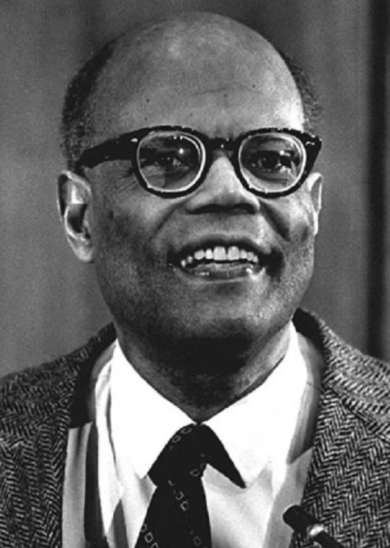
The Last Acceleration
The industrial research lab to routinize invention, and the modern corporation to routinize diffusion and deployment
Plus general purpose technologies—machine tools, non-human power sources
Arthur Lewis:
“New commodities: telephones, gramophones, typewriters, cameras, automobiles, and so on, a seemingly endless process whose latest twentieth-century additions include aeroplanes, radios, refrigerators, washing machines, television sets, and pleasure boats. Thus a rich man in 1870 did not possess anything that a rich man of 1770 had not possessed; he might have more or larger houses, more clothes, more pictures, more horses and carriages, or more furniture than say a school teacher possessed, but as likely as not his riches were displayed in the number of servants whom he employed rather than in his personal use of commodities…”
Not so much the particular technologies, as the grasping of the fact that there was a broad and deep range of new technologies to be discovered.
As much as it was new technologies, it was large-scale corporate organizations that could and did plan the division of labor to make use of and then market technologies.
And as much, it was that the global market meant that there was now a great deal of money to be made from the routinization of the exploration, development, and deployment of technological possibilities

Slide 19
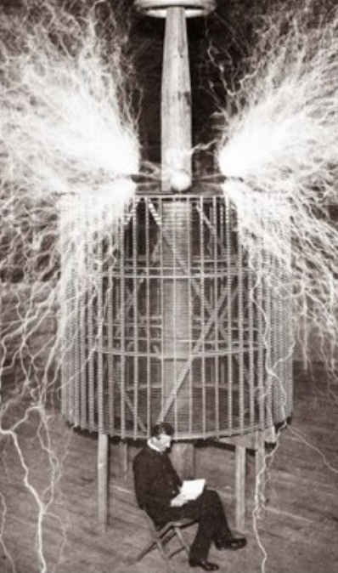
Who Is This Man?
And is he in any real danger?
Thomas Edison, and no
Andrew Carnegie, and no
Nicola Tesla, and no
Thomas Edison, and yes
Herbert Hoover, and yes

Slide 20
Nicola Tesla II
Went off to Graz, Austria, to go to college. Dropped out after two years.
Broke off relations with his family and friends
Worked as an engineer for two years
Suffered a “nervous breakdown”.
His father persuaded him to return to college at Prague’s Karl-Ferdinand University.
Perhaps he did.
But if so only for one summer.
And then his father died.
1881 finds Nikola Tesla working in Budapest for a startup, the National Telephone Company of Hungary, as chief electrician and chief engineer. But he does not stay.
1882 sees him in Paris working as an improver and adapter of American technology.
On June 6, 1884 Tesla arrived in New York with nothing in his pockets save a letter of recommendation from engineer Charles Batchelor to Thomas Edison: “I know of two great men,” Batchelor had written. “You are one of them. This young man is the other.” And so Edison hired Tesla.

Slide 21
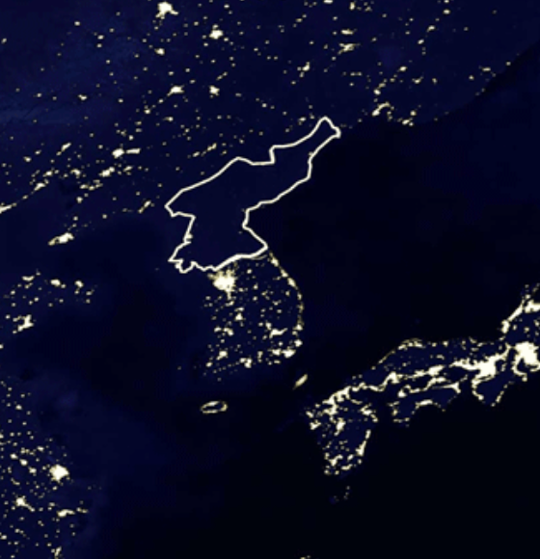
Nicola Tesla III
Tesla had an “eccentric personality,” as people put it. He wrote:
“I had a violent aversion against the earrings of women... bracelets pleased me more or less according to design. The sight of a pearl would almost give me a fit but I was fascinated with the glitter of crystals... I would get a fever by looking at a peach... I counted the steps in my walks and calculated the cubical contents of soup plates, coffee cups and pieces of food—otherwise my meal was unenjoyable. All repeated acts or operations I performed had to be divisible by three and if I missed I felt impelled to do it all over again, even if it took hours…"
To medicalize: autism/OCD. But is “medicalization” really something we want to do?
This, coupled with bizarre and utopian claims about the future course of science and technology, made it difficult for him to find and maintain financial backers and colleagues.
He was, as much as Mary Wollstonecraft Shelley’s fictional Dr. Viktor von Frankenstein, the very model of the lone mad scientist.
Yet George Westinghouse found a place for him:
Our entire electrical power grid and everything that draws off of it
Our electric appliances and engines today
Alternating-current generators, polyphase systems, and long-distance transmission through high-voltage power lines,
The world from space at night, illuminated by the electric power grid, is Tesla’s world.

Slide 22
Nicola Tesla IV
How could Tesla make a difference?
He made a difference because he could work for corporations
And his ideas could be developed and applied by corporations.
In America Tesla went to work for Edison Machine Works. He would later claim that Edison promised him $50,000—the entire net worth at the time of the Edison Machine Works, the same multiple of average wages back then that $7 million would be today, and the same share of GDP back then that $40 million would be today—to improve and redesign Edison’s direct current generators, but that in 1885 Edison refused to pay.
Tesla quit
Tesla found himself digging ditches for a living for a couple of years
Tesla on Edison’s death: Edison “had no hobby, cared for no sort of amusement of any kind and lived in utter disregard of the most elementary rules of hygiene .... His method was inefficient in the extreme, for an immense ground had to be covered to get anything at all unless blind chance intervened and, at first, I was almost a sorry witness of his doings, knowing that just a little theory and calculation would have saved him 90 percent of the labor. But he had a veritable contempt for book learning and mathematical knowledge, trusting himself entirely to his inventor's instinct and practical American sense...”

Slide 23
Nicola Tesla IVa
How could Tesla make a difference?
Nevertheless, Tesla found financial backers. Tesla made inventions.
1887 sees Tesla as the proprietor of Tesla Electric Light and Manufacturing (but his financial backers soon fire him from his own company).
1888 saw Tesla demonstrating an alternating-current induction motor—the ancestor of all our current alternating- current motors—at the American Institute of Electrical Engineers meeting.
1889 saw Tesla working at the Westinghouse Electric and Manufacturing Company’s laboratory in Pittsburg.
The late 1880s and 1890s saw Westinghouse and Tesla and their backers struggle against Edison and his backers in the so-called “war of the currents.” Thomas Alva Edison had bet on a direct current—DC—electrical grid. Direct current worked very well with incandescent lamps and with the motors of the day. Direct current fit well with storage batteries, which meant that you only had to build the expensive generating capacity for average loads rather than peak loads. And Edison had not understood what Tesla was getting at when Tesla worked for him: “[Tesla's] ideas are splendid, but they are utterly impractical...”

Slide 24
Nicola Tesla V
Tesla finds financial backers
Dominant financier J.P. Morgan backed Tesla, directly and indirectly, for a long while.
But then in 1907 Morgan decided that the heroic age of electricity was over
Time to rationalize operations
Time to replace the visionary inventors like Tesla and the executives like George Westinghouse who would cater to them.
Time for managers who would routinize the business, and focus on the bottom line.

Slide 25
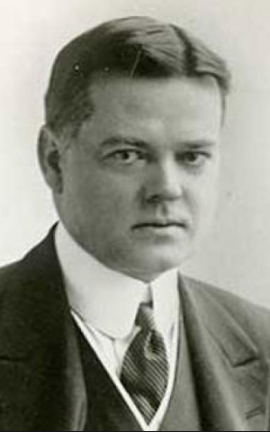
And Who Is This Man?
Andrew Carnegie
Theodore Roosevelt
Herbert Hoover
Thomas Edison
Somebody else

Slide 26
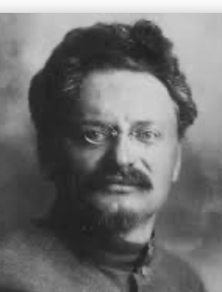
Lev Bronstein
Why did he say this?
“I had had no time to more than catch the general life-rhythm of the monster known as New York…”
“I left for Europe with the feeling of a man who has had only a peek into the furnace where the future is being forged…"

Slide 27
Governing America in 1900
America’s “aristocracy of manufactures”:
Tocqueville: “The territorial aristocracy of past ages… [was] obliged… to come to the help of its servants and relieve their distress” no such reciprocal ties of obligation bound the aristocrats of manufactures to their workers: thus “the manufacturing aristocracy which we see rising before our eyes is one of the hardest that have appeared on the earth…”
Lincoln: “The prudent, penniless beginner… saves a surplus… and at length hires another new beginner to help him…” And so he took “it that it is best for all to leave each man free to acquire… [and] get wealthy…”
“I agree with Judge Douglas [that the Negro] is not my equal in many respects—certainly not in color, perhaps not in moral or intellectual endowment. But in the right to eat the bread, without the leave of anybody else, which his own hand earns, he is my equal and the equal of Judge Douglas, and the equal of every living man…”

Slide 28
Tocqueville Rather than Lincoln Seemed to Describe America in 1900
“‘Land of opportunity’, you say. You know well my children will be where I am—that is, if I can keep them out of the gutter”:
Who was to blame for inadequate opportunity?: the rich, the easterners, immigrants, and the bankers (Jews)… <https://www.biblegateway.com/passage/?search=Matthew+21%3A33-46&version=KJV>
What was to be done?: Populists:
Free coinage of silver at a ratio of 16-to-1…
Boost the money supply…
Lower interest rates…
Raise farm prices…
Antitrust to bust monopolies and restore competition…
Railroad and other forms of rate regulation…
Populist movement broken on the altar of racial animosity, & fear of socialism…

Slide 29
“Progressives”
Democrats & Republicans: Woodrow Wilson and Theodore Roosevelt:
Progressives win the battle for mindshare in the history books
They failed to make that much of an impact on American policy before World War I
But the availability of the Populist and Progressive agendas made the shift in American politics in response to the Great Depression a generation later rapid and substantial
Pretty much every left-of-center (and some right-of-center) initiative that had been proposed between 1885 and 1914 was then dusted off and given a try, in Franklin Delano Roosevelt’s New Deal

Slide 30
Administration: Office Hours
DeLong: Office Hours
M 11:10-12:40, Blum Hall 200B
T 11:15-12:00, Blum Hall 200B
By appointment in Blum Hall 200B, Evans 691A, or elsewhere: email <delong@econ.berkeley.edu> Sign up at: <https://www.icloud.com/numbers/0leoOOlezWp6BYKSiPJhdXy7Q>
Paper due Feb 9: What Is Economics?: Assignment 3
UCLA professor Stephen Bainbridge believes that Partha Dasgupta's Economics: A Very Short Introduction is a bad book. He wrote, in his Amazon review: “1.0 out of 5 stars: Very disappointing, September 25, 2007: If you're looking for a VSI to Econ 101 and 102, skip this book. The treatment of microeconomic basics consists of exactly 14 pages. Macroeconomic theory gets a whopping 4 pages. The rest consists mainly of a political tract on wealth and poverty. It's the first VSI whose title amounts to a misrepresentation…"
Partha Dasgupta, of course disagrees. Which do you tend to agree with? (You can say that you are in the middle, but setting out and defending an "in the middle" position is actually very hard here.) Explain why and to what extent you come down on Dasgupta's or on Bainbridge's side of this dispute. Justify your opinions by setting out what you think economics is, or ought to be.
Write 400-500 words, and submit them on this webpage: <https://bcourses.berkeley.edu/courses/1487684/assignments/8051996>
By now you should have read not just Dasgupta but Eichengreen chapters 1 & 2
Memo: bCourses website <https://bcourses.berkeley.edu/courses/1487684>

Slide 31
Paper
Due Feb 9: What Is Economics?: Assignment 3
UCLA professor Stephen Bainbridge believes that Partha Dasgupta's Economics: A Very Short Introduction is a bad book. He wrote, in his Amazon review: “1.0 out of 5 stars: Very disappointing, September 25, 2007: If you're looking for a VSI to Econ 101 and 102, skip this book. The treatment of microeconomic basics consists of exactly 14 pages. Macroeconomic theory gets a whopping 4 pages. The rest consists mainly of a political tract on wealth and poverty. It's the first VSI whose title amounts to a misrepresentation…"
Partha Dasgupta, of course disagrees. Which do you tend to agree with? (You can say that you are in the middle, but setting out and defending an "in the middle" position is actually very hard here.) Explain why and to what extent you come down on Dasgupta's or on Bainbridge's side of this dispute. Justify your opinions by setting out what you think economics is, or ought to be.
Write 400-500 words, and submit them on this webpage: <https://bcourses.berkeley.edu/courses/1487684/assignments/8051996>

Slide 32
DeLong Office Hours
M 11:10-12:40, Blum Hall 200B
T 11:15-12:00, Blum Hall 200B
By appointment in Blum Hall 200B, Evans 691A, or elsewhere:
email <delong@econ.berkeley.edu>
Sign up at: <https://www.icloud.com/numbers/0leoOOlezWp6BYKSiPJhdXy7Q>

Slide 33
Memo
By now you should have read not just Dasgupta but Eichengreen chapters 1 & 2
bCourses website <https://bcourses.berkeley.edu/courses/1487684>

Slide 34
Governing Chicagoland in the 1890s
Chicago 1840: 4000. Chicago 1900: 2,000,000—70% born outside the United States:
1886: AFL general strike for the 8-hour workday: Haymarket bombing May 3 (8/20)
1889: AFL President Samuel Gompers; May Day
1893: Altgeld pardons three surviving “Haymarket bombers”—blames Pinkertons
1894: TTB Grover Cleveland: Labor Day holiday in September instead
1894: Pullman Strike
Cleveland attached a mail car to every train
Cleveland ordered the U.S. army into Chicago
Art. IV §4: “on application of the [state] legislature, or the executive (when the legislature cannot be convened).”
Altgeld pointed out that neither he nor the legislature had applied
Cleveland responded that it was more important to protect property against rioters, anarchists, and socialists: “If it takes the entire army and navy of the United States to deliver a postcard in Chicago, that card will be delivered!”
On July 7, 1894 Debs and the other union leaders were arrested for violating the terms of the injunction, and the strike collapsed

Slide 35
Darrow’s Summary
What the federal government intervention did:
“The men left the railroads en masse to keep their wages from being cut and working conditions lowered. The railroads resisted because to yield meant greater cost.... Both sides were right, but I wanted to see the workers win. I knew of no way to determine what a workman should be paid; what he should have in a way is determined by what he can get, and, so far as we can see, every one’s compensation is settled the same way....If there are still any citizens interested in protecting human liberty, let them study the conspiracy laws of the United States…”

Slide 36
1896 Democratic National Convention
Control seized by the Democratic wing of the Democratic Party. The platform:
condemned the gold standard (supported by Cleveland)
condemned government by injunction against labor unions (used by Cleveland)
supported federalism (violated by Cleveland)
called for a Supreme Court that would declare an income tax constitutional or an income tax amendment
called for support for the right to unionize
called for personal and civil liberties.
Young William Jennings Bryan wowed the convention and defeated former Senator Richard Bland for the nomination
President Grover Cleveland and his supporters abandoned the Democratic Party, and ran ex-Republican Illinois governor and ex-Union general John M. Palmer and ex-Kentucky governor and ex-Confederate general Simon Bolivar Buckner to split off votes from William Jennings Bryan and Arthur Sewall

Slide 37
Republican Rhetoric
Corn-fed William Jennings Bryan 100% American Native! So focus attention on Altgeld:
Theodore Roosevelt: “Mr. Altgeld… much more dangerous… than Bryan… slyer, much more intelligent, much less silly… from all the restraints of public morality…. The one plans wholesale repudiation [of the gold standard] with a light heart and bubbly eloquence, because he lacks intelligence... the other would connive at wholesale murder and would justify it by elaborate and cunning sophistry for reasons known only to his own tortuous soul…”
Harper’s Weekly: “Governor Altgeld... is the brains.... Bryan... would be as clay… under the astute control of the ambitious and unscrupulous Illinois communist... silver... but a step towards the general socialism which is the fundamental doctrine…”
In the 1876, 1880, 1884, 1888, and 1892 elections the Republicans had won by 20,000, won by 7,000, lost by 60,000, won by 2,000, and lost by 380,000 votes.
Against Bryan the Republicans won by 600,000 votes

Slide 38
Over in Europe
The June Days of 1848 in Paris:
Tocqueville:
“The insurrection of June [1848]... class against class... a blind and rude, but powerful, effort on the part of the workmen to escape from the necessities of their condition, which had been depicted to them as one of unlawful oppression…. The closing of the national workshops… occasioned the rising…”
“Thousands… hastening to our aid from every part of France.... Thanks to the railroads, some had already come from fifty leagues’ distance... every class of society... peasants... shopkeepers... landlords and nobles all mingled together... they rushed into Paris with unequalled ardour: a spectacle as strange and unprecedented in our revolutionary annals.... The insurgents received no reinforcements, whereas we had all France for reserves…”

Slide 39
French Politics
Régimes stability is not on the menu:
the terrorist dictatorship of the Jacobins (the mainspring of popular government… amid revolution it is at once virtue and terror: virtue, without which terror is fatal; terror, without which virtue is impotent…)
a corrupt and gerrymandered 5-man executive of the Directory, defended on October 5, 1795 by the “whiff of grapeshot” of Napoleon Bonaparte and Joachim Murat, that managed to generate the first modern hyperinflation, defended itself against a royalist coup plotted by two of its five members (Barthelemy and Carnot) and its most successful general (Pichegru), and was then overthrown by the same Napoleon in 1799.
a dictatorship, with Napoleon Bonaparte as “First Consul”, until 1804.
an empire, with Napoleon Bonaparte as Emperor of the French, until suppressed by the other European powers in 1815.
a restored Bourbon monarchy, with first Louis XVIII and then Charles X, until 1830.
an alternative Orleanist monarchy, with King Louis-Philippes as the king-citizen, overthrown in 1848.
a second republic, overthrown by its own president, Napoleon’s nephew Louis Napoleon, which collapsed under pressure of military defeat in 1870.
a socialist commune, in Paris at least.
a third republic, which suppressed the commune—but promptly chose a royalist Marshal MacMahon, as president.
a failed attempt by third republic president Marshal MacMahon to replace himself by a King Henry V.
a failed attempt by the ex-Minister of War Georges Boulanger to seize power for his RRR movement: Revanche, Révision, Restauration (revenge on Germany, revision of the constitution, restoration of the monarchy).

Slide 40
Left-Wing Normal European Politics
Disjunction between policies and rhetoric:
The Socialist Party of Germany’s Erfurt and Gotha programs seek things like: holidays for elections, two-year legislative terms, the right to bear arms, equal rights for women, the prohibition of spending public funds for religious purposes, free public schools and colleges, free medical care including midwifery, an eight-hour working day, no child labor under 14, a 36-hour minimum weekend, an occupational safety and health administration
But also: “By every lawful means to bring about a free state and a socialistic society, to effect the destruction of the iron law of wages by doing away with the system of wage labor.” And they sought: “the transformation of the capitalist private ownership of the means of production—land and soil, pits and mines, raw materials, tools, machines, means of transportation—into social property and the transformation of the production of goods into socialist production carried on by and for society.” And they believed: “This… emancipation… of the entire human race…. But it can only be the work of the working class, because all other classes… have as their common goal the preservation of the foundations of contemporary society.”

Slide 41
Center and Right-Wing Normal European Politics
The touchstone was “fairness”: it was not fair that those who did not work hard and did not play by the rules got lots of good things:
Those who did not play by the rules could be on either end of the wealth-and-power spectrum:
Parasitic aristocrats and cruel plutocrats
Those poor who wanted something for nothing, or got above their station
A middle-class, social order movement
Focus voters’ attention on the disruptive utopian aspirations of the left, and electoral coalitions could be preserved…
Preserve as much as possible of old orders of hierarchy in changing times:
Reform to preserve; change so things could stay the same
Find new reasons why hierarchy is good: social darwinism

Slide 42
Magnifying Non-Economic Cleavages Had Dangers
Society under threat not by economic inequality but by social disorder—or aliens—or other nations. Plus:
A right-wing landed and bureaucratic upper class that had, by and large, lost its social role.
A belief by politicians anxious to paper over class divisions that they could be papered over with national or ethnic unity.
A growing social-darwinist current that struggle was good, and the victors should be rewarded
Eeven or especially military struggle by peoples-in-arms over not what language a province would be administered in but who would live there
These stored up trouble as 1914 approached.
In 1919 John Maynard Keynes was to write, bitterly, that he, his peers, and his elders had regarded:
“the projects and politics of militarism and imperialism, of racial and cultural rivalries, of monopolies, restrictions, and exclusion, which were to play the serpent to this paradise… [as] little more than the amusements of his daily newspaper…”

Slide 43
Takeaways
Chapters 5: North Atlantic Political Economy 1870-1913
Polanyi
(Also Marx, Keynes, Hayek, Gellner, Tocqueville, Acheson)
land, labor, finance; fictitious commodities; double movement
Tocqueville’s fears
Lincoln’s hopes
The sense that it all was going wrong
Populists
Progressives
Conflict between left-wing rubber-meets-the-road policies and utopian aspirations
Appeals to social order and to playing by the rules
Preservation of hierarchy and traditions
Disruptions of changes
Deserved rewards to the successful
Social darwinism & nationalism

Slide 44
Preview: Next Time
On to Chapters 6 & 7: Empire and War 1870-1914:
Empire in the age of an extraordinary technological gradient
Different stories in different places
Scrambles:
For India
For Egypt
For Africa, and elsewhere
For informal influence in Latin America
China
Herbert Hoover again
Informal economic hegemony:
Emulating Britain looked good
Breaking Britain’s rules was costly
For privates, playing along was profitable
Freedom of investment
Japan’s Meiji Restoration
Empire and war
The knot of war
Economic illogic
Rehearsal: The Boer War
Nationalism
War “aims”
That DFT in the Balkans
German attacks Belgium
Why not a short war?
The Prussian way of war
German technology and industry
Attrition and exhaustion

Slide 45
What Was Unconvincing Today?
Mistakes and unclarities: typos, wordos, and mindos…
In the DRAFT textbook?
In the lecture?

Slide 46
Catch Our Breath…
Ask a couple of questions?
Make a couple of comments?
Any more readings to recommend?

Slide 47

Edward Bellamy: Looking Backward
Edward Bellamy: Looking Backward <https://delong.typepad.com/files/bellamy-backward.pdf>: Perhaps the third best-selling novel of the 19th century in the United States
2000 is a utopia…
The narrator is carried forward in time from 1887-2000 by an implausible plot device:
‘“This is the tenth day of September in the year 2000, and you have slept exactly one hundred and thirteen years, three months, and eleven days…”’
He then wanders around, looking at the utopia of 2000…
The opening:
‘“How could I live without service to the world?” you ask…. The answer is that my great-grandfather had accumulated a sum of money on which his descendants had ever since…. The sum had been originally by no means large. It was, in fact, much larger now that three generations had been supported upon it in idleness, than it was at first…’

Slide 48
The Stagecoach of Society
Those who ride and this who pull:
‘Commiseration was frequently expressed by those who rode for those who had to pull the coach, especially when the vehicle came to a bad place in the road, as it was constantly doing, or to a particularly steep hill. At such times, the desperate straining of the team, their agonized leaping and plunging under the pitiless lashing of hunger, the many who fainted at the rope and were trampled in the mire, made a very distressing spectacle, which often called forth highly creditable displays of feeling on the top of the coach.
‘At such times the passengers would call down encouragingly to the toilers of the rope, exhorting them to patience, and holding out hopes of possible compensation in another world for the hardness of their lot, while others contributed to buy salves and liniments for the crippled and injured. It was agreed that it was a great pity that the coach should be so hard to pull, and there was a sense of general relief when the specially bad piece of road was gotten over. This relief was not, indeed, wholly on account of the team, for there was always some danger at these bad places of a general overturn in which all would lose their seats.
‘It must in truth be admitted that the main effect of the spectacle of the misery of the toilers at the rope was to enhance the passengers’ sense of the value of their seats upon the coach, and to cause them to hold on to them more desperately than before…

Slide 49
The Stagecoach of Society II
“Finer clay”:
‘The other fact is yet more curious, consisting in a singular hallucination which those on the top of the coach generally shared, that they were not exactly like their brothers and sisters who pulled at the rope, but of finer clay, in some way belonging to a higher order of beings who might justly expect to be drawn. This seems unaccountable, but, as I once rode on this very coach and shared that very hallucination, I ought to be believed.
‘The strangest thing about the hallucination was that those who had but just climbed up from the ground, before they had outgrown the marks of the rope upon their hands, began to fall under its influence. As for those whose parents and grand-parents before them had been so fortunate as to keep their seats on the top, the conviction they cherished of the essential difference between their sort of humanity and the common article was absolute. The effect of such a delusion in moderating fellow feeling for the sufferings of the mass of men into a distant and philosophical compassion is obvious.
‘To it I refer as the only extenuation I can offer for the indifference which, at the period I write of, marked my own attitude toward the misery of my brothers…

Slide 50
The Stagecoach of Society III
Class war:
‘The sanguine argued very forcibly that it was in the very nature of things impossible that the new hopes of the workingmen could be satisfied, simply because the world had not the wherewithal to satisfy them. It was only because the masses worked very hard and lived on short commons that the race did not starve outright, and no considerable improvement in their condition was possible while the world, as a whole, remained so poor.
‘It was not the capitalists whom the laboring men were contending with, these maintained, but the iron-bound environment of humanity, and it was merely a question of the thickness of their skulls when they would discover the fact and make up their minds to endure what they could not cure.
The less sanguine admitted all this. Of course the workingmen’s aspirations were impossible of fulfillment for natural reasons, but there were grounds to fear that they would not discover this fact until they had made a sad mess of society. They had the votes and the power to do so if they pleased, and their leaders meant they should. Some of these desponding observers went so far as to predict an impending social cataclysm. Humanity, they argued, having climbed to the top round of the ladder of civilization, was about to take a header into chaos…’

Slide 51
The Limit of Human Felicity
Technological marvels of 2000: great cities, Amazon drop-shipments, music
Julian West expects Edith Leete to play the piano, but:
‘“Nothing would delight me so much as to listen to you,” I said.
‘“To me!” she exclaimed, laughing. “Did you think I was going to play or sing to you?”
‘“I hoped so, certainly,” I replied.
‘Seeing that I was a little abashed, she subdued her merriment and explained. “Of course, we all sing nowadays as a matter of course in the training of the voice, and some learn to play instruments for their private amusement; but the professional music is so much grander and more perfect than any performance of ours, and so easily com- manded when we wish to hear it, that we don’t think of calling our singing or playing music at all. All the really fine singers and players are in the musical service, and the rest of us hold our peace for the main part. But would you really like to hear some music?”…’

Slide 52
The Limit of Human Felicity II
In the music room:
‘She made me sit down comfortably, and, crossing the room, so far as I could see, merely touched one or two screws, and at once the room was filled with the music of a grand organ anthem; filled, not flooded, for, by some means, the volume of melody had been per- fectly graduated to the size of the apartment. I listened, scarcely breathing, to the close. Such music, so perfectly rendered, I had never expected to hear.
‘“Grand!” I cried, as the last great wave of sound broke and ebbed away into silence. “Bach must be at the keys of that organ; but where is the organ?”…
‘“There are a number of music rooms in the city, perfectly adapted acoustically to the different sorts of music. These halls are connected by telephone with all the houses of the city…. Any one of the four pieces now going on that you prefer, you can hear by merely pressing the button which will connect your house-wire with the hall where it is being rendered…”’

Slide 53
The Limit of Human Felicity III
Four live orchestras you can listen to on the speakerphone!
‘“It appears to me, Miss Leete,” I said, “that if we could have devised an arrangement for providing everybody with music in their homes, perfect in quality, unlimited in quantity, suited to every mood, and beginning and ceasing at will, we should have considered the limit of human felicity already attained, and ceased to strive for further improvements…”’

Slide 54
Feminism
The elimination of housework—and of the servant class:
‘“Who does your house-work, then?” I asked.
‘“There is none to do,” said Mrs. Leete.… “Our washing is all done at public laundries at exces- sively cheap rates, and our cooking at public kitchens. The making and repairing of all we wear are done outside in public shops. Elec- tricity,* of course, takes the place of all fires and lighting. We choose houses no larger than we need, and furnish them so as to involve the minimum of trouble to keep them in order. We have no use for domestic servants….
‘“What a paradise for womankind the world must be now!” I exclaimed. “In my day, even wealth and unlimited servants did not enfranchise their possessors from household cares, while the women of the merely well-to-do and poorer classes lived and died martyrs to them…”’

Slide 55
The View from 3000: Themes & Big Ideas
Science reaches critical mass and from it springs engineering—all of the engineering subdisciplines, including the management of human resources and of organizations. From a liberal political order spring national and then the global market economy. And from engineering and the market then, over the course of 1870-2016, spring…
History was economic…
Explosion of wealth…
Cornucopia of technology…
Demographic transition…
Feminist revolution…
Empowered tyrannies…
Wealth gulfs…
Inclusion and hierarchy attenuation…
Mismanagement and insecurity…

Slide 56
Measuring Growth
Is it the case that British Queen Victoria I Hanover was a better queen but not a happier woman than Queen Elizabeth I Tudor?
Yes
No
Not sure

Slide 57
Measuring Growth II
What are my estimates of the rate of growth of economically-useful human knowledge over 1-1500, 1500-1800, 1800-1870, and 1870-2000?
0.02%/year, 0.2%/year, 0.5%/year, and 0.8%/year
0.000%/year, 0.02%/year, 0.2%/year, and 0.8%/year
0.02%/year, 0.2%/year, 0.8%/year, and 2.3%/year
0.2%/year, 0.8%/year, 2.3%/year, and 4.7%/year
None of the above.

Slide 58
What Is the Key Factor in the Explosion of Wealth in the 20th Century?
Yes, many things contributed. But suppose you have to pick just one

Slide 59
What Are the Four Factors That I See as Making for the Explosion of Wealth in the 20th Century?
Yes, there are many, many more things that contributed. But suppose you have to pick just four:

Slide 60
Demography
What is the “demographic transition”?

Slide 61
Demography II
What is the principal cause of the demographic transition?
Female wealth and control of property.
Female literacy.
Falling infant and child mortality.
Land shortages and high unemployment.
Something else.

Slide 62
Feminism
How many pregnancies do we think Abigail Smith Adams had between when she was 20 and 34?
2.
4.
6.
8.
18.

Slide 63
Empowered Tyrannies II
How many world leaders are members of the 10-million club?
2.
4.
6.
8.
18.

Slide 64
Wealth Gulfs
What fraction of humanity has not climbed onto the “escalator to modernity”?
10%
1%
50%
75%
We cannot yet tell.

Slide 65
Inclusion and Hierarchy Attenuation
At the start of the 1970s, future President Ronald Reagan said that diplomats from Tanzania appeared uncomfortable:
resisting pressure to vote with the Soviet Union at the United Nations.
making small talk with New York socialites.
wearing shoes.
in formal tuxedos.
None of the above.

Slide 66
Economic Mismanagement and Insecurity
Karl Polanyi argued that people have rights to what things that the market economy turns into “commodities”?
land (a stable community), labor (a “just” income), and finance (a stable economic place).
labor (a “just” income), finance (a stable economic place), and property (the ability to keep what you earn).
labor (a “just” income), finance (a stable economic place), and respect (deference from your peers).
land (a stable community), property (the ability to keep what you earn), and finance (a stable economic place).
None of the above.

Slide 67
Economic Mismanagement and Insecurity II
According to Karl Polanyi, what rights does the market economy respect?
rights to land (a stable community).
rights to labor (a “just” income).
rights to finance (a stable economic place).
rights to property (the ability to keep what you earn).
None of the above.

